Slide 1

SMART GARDENING ASSISTANT
Year / Semester: III/ I
Branch / Section: DS / Alpha
Student Names(Roll Nos):
A .Madhuri(2311CS030038)
B .Rakesh(2311cs030056)
B .Namitha Reddy(2311Cs030088)
A.Srivalli(2311CS030007)

Slide 2
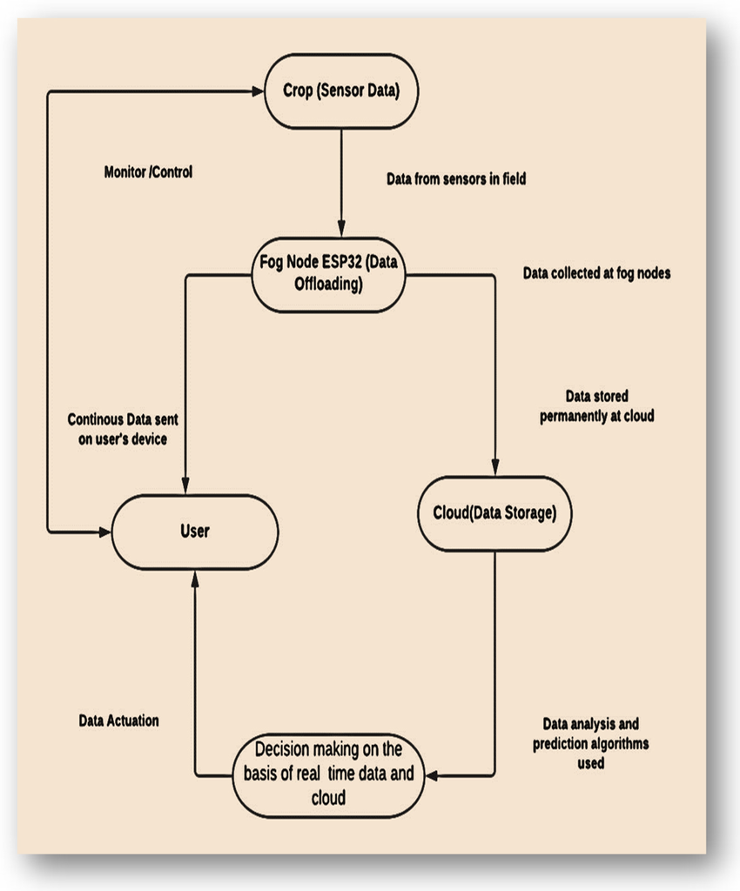
DATA FLOW DIAGRAMS

Slide 3
Modules
1. Image Processing & Disease Detection Module:
Purpose: Detects and classifies plant diseases from images.
Key:
Image preprocessing (resizing, noise removal, normalization)
Feature extraction using CNN (Convolutional Neural Networks) or Transfer Learning models.
Disease classification (healthy vs. infected, type of disease)
2. Plant & Disease Database Module
Stores information about plants, diseases, symptoms, and pesticide options. Key :
Structured database of plant species and common diseases
Symptom–disease–pesticide relationships
Metadata for organic vs. chemical pesticide options
3. Pesticide Recommendation Module:
Suggests effective pesticides or treatments based on detected disease. Key:
Maps detected disease to appropriate pesticide(s)
Provides dosage, application frequency, and safety instructions
Suggests eco-friendly alternatives or integrated pest management (IPM) tips

Slide 4
Results
1.Automation of Tasks:​
​Automated Fertilization: Lights and nutrient delivery are managed on a precise, optimized schedule.​
2.Real-Time Monitoring:
Users get instant insights into the garden's environment, tracking key parameters like:​Temperature and Humidity​Soil Moisture and pH levels​Light Intensity​
3.Convenience and Low Maintenance:
The ability to monitor and control the garden remotely via the app, often with an "autopilot" mode, allows plants to thrive even when the user is away (e.g., Vacation Mode).​
4.Optimized Plant Conditions:
By consistently maintaining the ideal environment, users achieve faster growth rates and more consistent results compared to traditional gardening.

Slide 5
Conclusion and Future Scope
​1.Predictive Plant Care:
Moving from simple reminders to using AI to analyze historical data and current sensor readings to predict when a plant will need water, nutrients, or pest treatment before it shows signs of stress.​
2.Recommendations:
AI models will better integrate hyper-local weather patterns, soil types, and plant genetics to provide climate-smart advice, helping gardeners adapt to changing environmental conditions.​
Conclusion:
It ensures optimal plant health and increased yields by providing precision care, expert AI-driven advice, and timely intervention for pests/diseases, reducing the learning curve for all user levels.Through automation (especially for watering and lighting) and remote monitoring, it drastically reduces manual effort and resource waste, promoting sustainability by conserving water and energy.

Slide 6
yes ye
References
Reference: Springer Open
Springer Open is a portfolio of more than 160 fully open access journals and books published by Springer Nature that cover all areas of science, technology, medicine, humanities, and social sciences. Articles are freely available online immediately upon publication, with authors retaining copyright under a Creative Commons license that allows for reuse and redistribution as long as proper citation is provided. The journals undergo a peer-review process to ensure the quality of published work.
Link: https://www.springeropen.com/journals

Slide 7
THANK YOU

